Slide 1

Identifying Abandoned Buildings In Aerial Imagery
Zachary Brown, Data Scientist at NASA

Slide 2


Slide 3
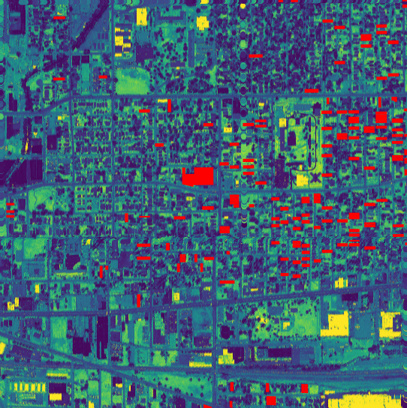

Slide 4
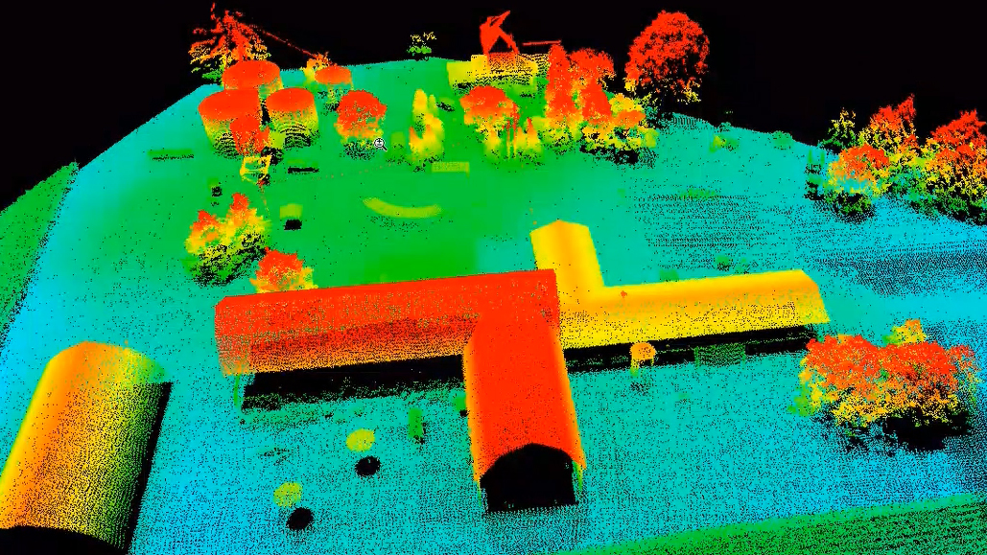
Problem Statement
Train a model that takes LiDAR imagery of Indianapolis, IN and classifies a building as either occupied or vacant.

Slide 5

Benefits
Association with violent crime¹
Current approach is time and resource intensive
Branas, C. C., Rubin, D., & Guo, W. (2012). Vacant properties and violence in neighborhoods.
https://repository.upenn.edu/cgi/viewcontent.cgi?article=1004&context=cml_papers
Notes:
This analysis of violence in neighborhoods found a significant association between vacant properties and the risk of aggravated assault—and particularly gun assaults—even after controlling for important demographic and socioeconomic characteristics of the neighborhoods. Vacant properties also had the strongest effect size, prevailing over almost a dozen well-known indicators of disadvantage.

Slide 6

Challenges
Find the data
Merge separate datasets
Model choice and tuning

Slide 7

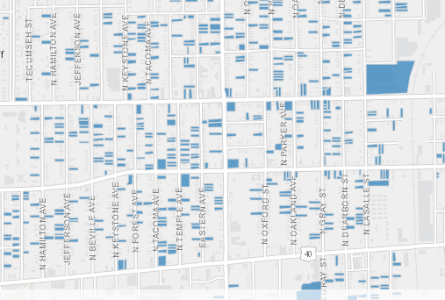
Challenge #1
Finding the Data
Government
Indianapolis, IN
Updated weekly

Slide 8
Challenge #1
Finding the Data
Building imagery
LiDAR
US Dept. of Agriculture
2016

Slide 9

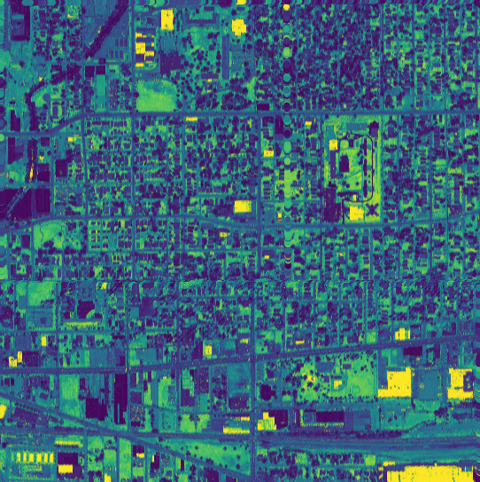
Challenge #2
Merging the Data

Slide 10
Challenge #2
Merging the Data
Transform Coordinate Reference System
Check 11.3 million points
Geopandas, Shapely, Laspy

Slide 11
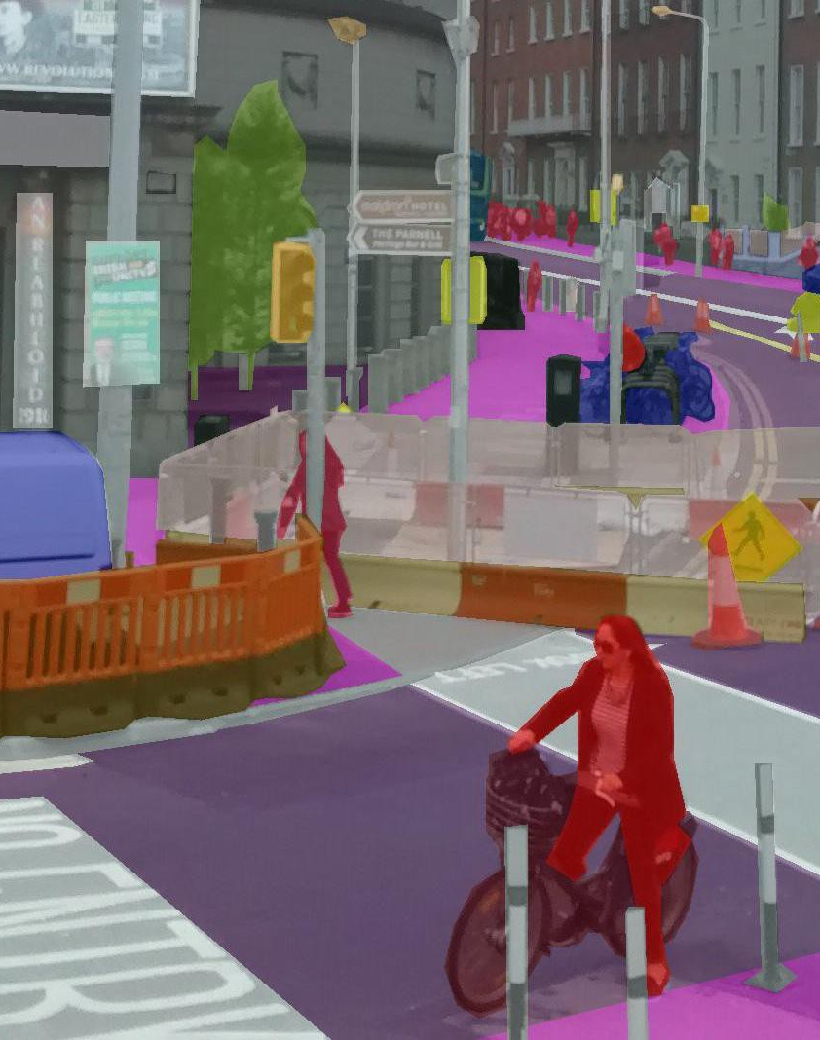
Image Segmentation
Autonomous cars
Medical imaging
Building and tree identification
Notes:
Otherwise known as pixel-based classification. This approach classifies each pixel as belonging to a particular class.

Slide 12

Challenge #3
Modeling
294,848 Pixels
Accuracy
Sensitivity

Slide 13
Training
 | Accuracy % change | Sensitivity
K-means | -3.92 % | 4.75 %
MLP Classifier | 0 % | 0 %
SVM | 0 % | 0.26 %

Slide 14
Testing
 | Accuracy % change | Sensitivity
K-means | -0.14 % | 0 %
MLP Classifier | -0.63 % | 0 %
SVM | -0.62 % | 0 %

Slide 15
Recommendations

Slide 16

What’s Next?
Satellite images
U-net model
Smaller tile size
Google Street View

Slide 17

THANKS!
Any questions?
You can find me at:
@username
myemail@domain.com

Slide 18

CREDITS
Special thanks to all people who made and shared these awesome resources for free:
Presentation template designed by powerpointify.com
Photographs by unsplash.com
Graphics by freepik.com
Airplane image: https://www.technocrazed.com/wp-content/uploads/2015/12/Airplane-wallpaper-123.jpg
Airplane view: http://mariuszjeglinski.com/blog/wp-content/uploads/2016/06/New-York-City-2.jpg
Image segmentation: https://miro.medium.com/max/4800/1*rZ1vDrOBWqISFiNL5OMEbg.jpeg
Fred Flinstone: https://www.deviantart.com/rovertarthead/art/Fred-Flintstone-thinks-377430958
NYC: https://cdn.businessinsider.de/wp-content/uploads/2019/06/new-york-city-manhattan.jpg

Slide 19
PRESENTATION DESIGN
This presentation uses the following typographies and colors:
Free Fonts used:
https://www.fontsquirrel.com/fonts/mukta
Colors used:

